Slide 1
Non-GUI Events

Slide 2
Learning Objectives
In this lesson you will:
learn non-GUI events
understand how the Watch Service API works
learn how to use the Watch Service API

Slide 3
Non-GUI Events
events that are not caused by user’s interaction with the GUI
Examples
Alarm clock
Event-based Parser – e.g. SAX (Simple API for XML)
it emits events as it reads an XML file allowing you to capture those events with your own code
It was created to make reading of XML files more simple than hand-parsing a plain text.
File Change Notification – Watch Service API
designed for applications that need to be notified about file change events.

Slide 4
Java Watch Service API
enables you to register a directory (or directories) with the watch service.
When registering, you tell the service which types of events you are interested in: file creation, file deletion, or file modification.
When the service detects an event of interest, it is forwarded to the registered process.
The registered process has a thread (or a pool of threads) dedicated to watching for any events it has registered for.
When an event comes in, it is handled as needed.

Slide 5
Implementing a Watch Service
Create a WatchService "watcher" for the file system.
For each directory that you want monitored, register it with the watcher.
When registering a directory, you specify the type of events for which you want notification.
You receive a WatchKey instance for each directory that you register.
Implement an infinite loop to wait for incoming events.
When an event occurs, the key is signaled and placed into the watcher's queue.
Retrieve the key from the watcher's queue.
You can obtain the file name from the key.
Retrieve each pending event for the key (there might be multiple events) and process as needed.
Reset the key, and resume waiting for events.
Close the service
The watch service exits when either the thread exits or when it is closed (by invoking its closed method).

Slide 6
Creating a Watch Service and Registering for Events
Create a new WatchService by using the new WatchService method in the FileSystem class, as follows:
WatchService watcher = FileSystems.getDefault().newWatchService();
Register one or more objects with the watch service.
Any object that implements the Watchable interface can be registered.
The Path class implements the Watchable interface, so each directory to be monitored is registered as a Path object.

Slide 7
Creating a Watch Service and Registering for Events
When registering an object with the watch service, you specify the types of events that you want to monitor.
Supported StandardWatchEventKinds event types:
ENTRY_CREATE – A directory entry is created.
ENTRY_DELETE – A directory entry is deleted.
ENTRY_MODIFY – A directory entry is modified.
OVERFLOW – Indicates that events might have been lost or discarded. You do not have to register for the OVERFLOW event to receive it.

Slide 8
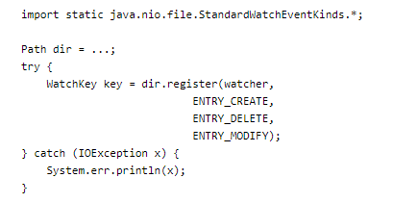
Creating a Watch Service and Registering for Events
The following code snippet shows how to register a Path instance for all three event types:

Slide 9
Processing Events
Get a watch key.
Three methods are provided:
poll – Returns a queued key, if available. Returns immediately with a null value, if unavailable.
poll(long, TimeUnit) – Returns a queued key, if one is available. If a queued key is not immediately available, the program waits until the specified time. The TimeUnit argument determines whether the specified time is nanoseconds, milliseconds, or some other unit of time.
take – Returns a queued key. If no queued key is available, this method waits.
Process the pending events for the key.
fetch the List of WatchEvents from the pollEvents method.

Slide 10
Processing Events
Retrieve the type of event by using the kind method.
No matter what events the key has registered for, it is possible to receive an OVERFLOW event. You can choose to handle the overflow or ignore it, but you should test for it.
Retrieve the file name associated with the event.
The file name is stored as the context of the event, so the context method is used to retrieve it.
After the events for the key have been processed, you need to put the key back into a ready state by invoking reset.
If this method returns false, the key is no longer valid and the loop can exit. This step is very important. If you fail to invoke reset, this key will not receive any further events.

Slide 11
Watch Key
A watch key has a state. At any given time, its state might be one of the following:
Ready - indicates that the key is ready to accept events. When first created, a key is in the ready state.
Signaled - indicates that one or more events are queued. Once the key has been signaled, it is no longer in the ready state until the reset method is invoked.
Invalid - indicates that the key is no longer active. This state happens when one of the following events occurs:
The process explicitly cancels the key by using the cancel method.
The directory becomes inaccessible.
The watch service is closed.

Slide 12
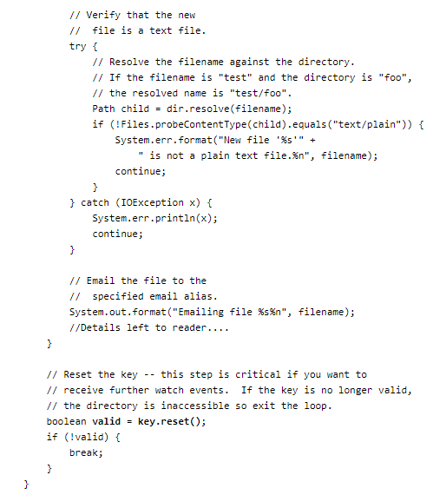
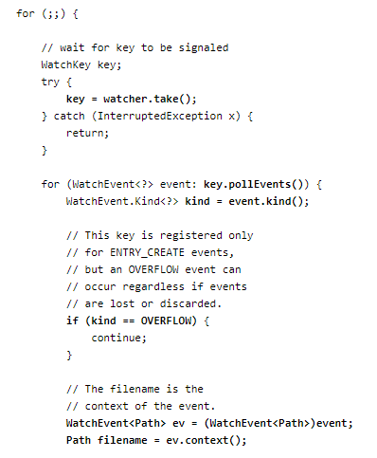

Slide 13
Summary
Non-GUI events are not caused by user’s interaction with the GUI
Examples of non-GUI events are Alarm Clocks, SAX and Watch Service API
Watch Service API is a file change notification API found in the java.nio.file package

Slide 14
Reference
The Java Tutorials – Oracle Java Documentation

